Slide 1
Positive Peak Detector
New Peak Comparators
Positive and Negative Peak Set-Reset Cycle
Signal Input
Flip-Flop #1
Negative Peak Detector
Octave Divider
Signal Output
Filtering
JFET Muting
Flip-Flop #2

Slide 2
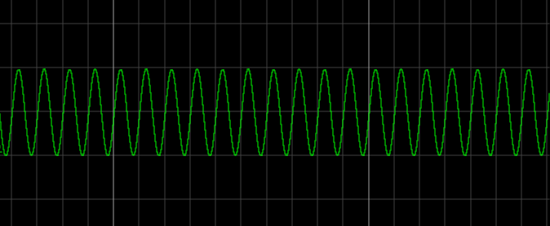
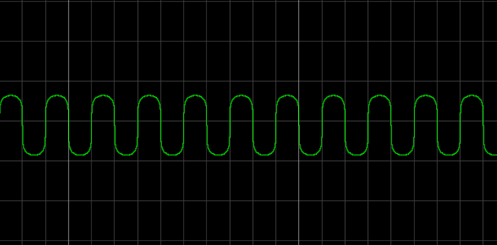
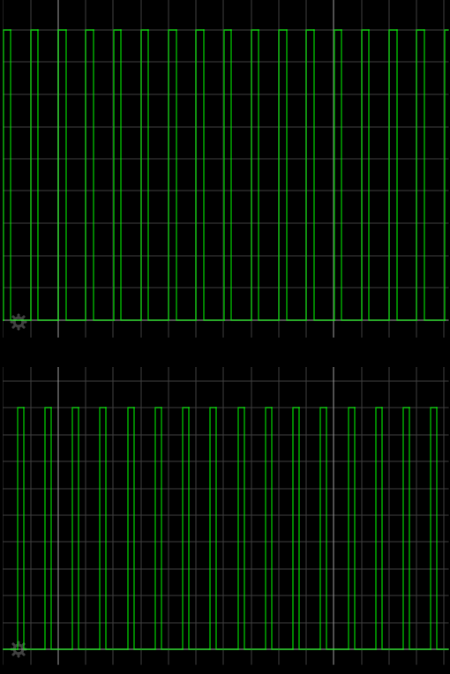
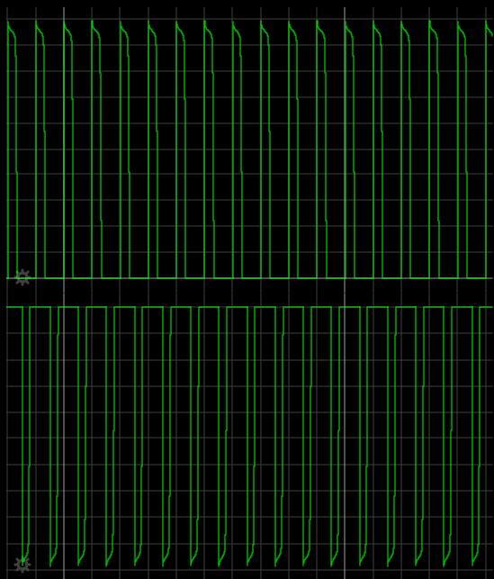
Input Signal
Clipping Stage
Top Peaks
Bottom Peaks
Comparator Stage
Peak Detector Stage

Slide 3
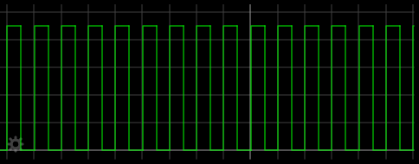
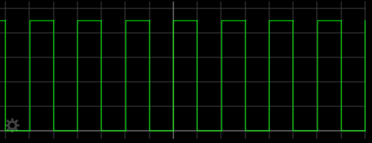
Flip Flop #1: Set-Reset Cycle Generator
Flip Flop #2: Period Doubler

Slide 4
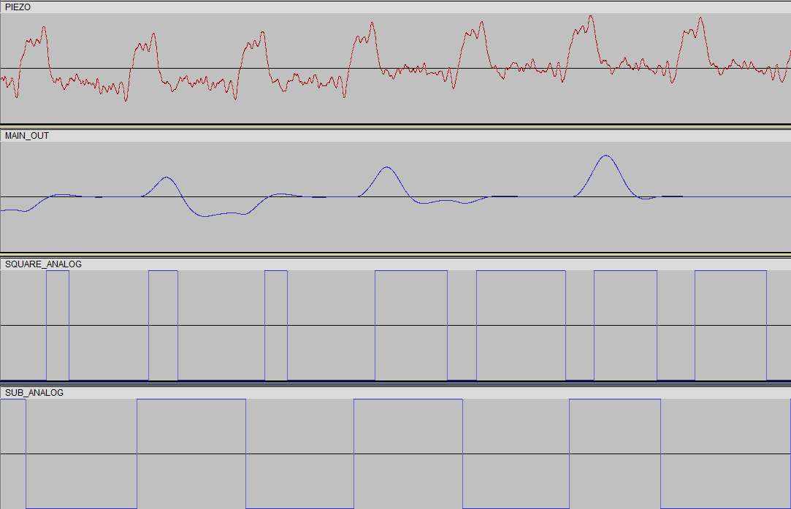
Signal Content Changes
Muting Signal Phase Changes

Slide 5
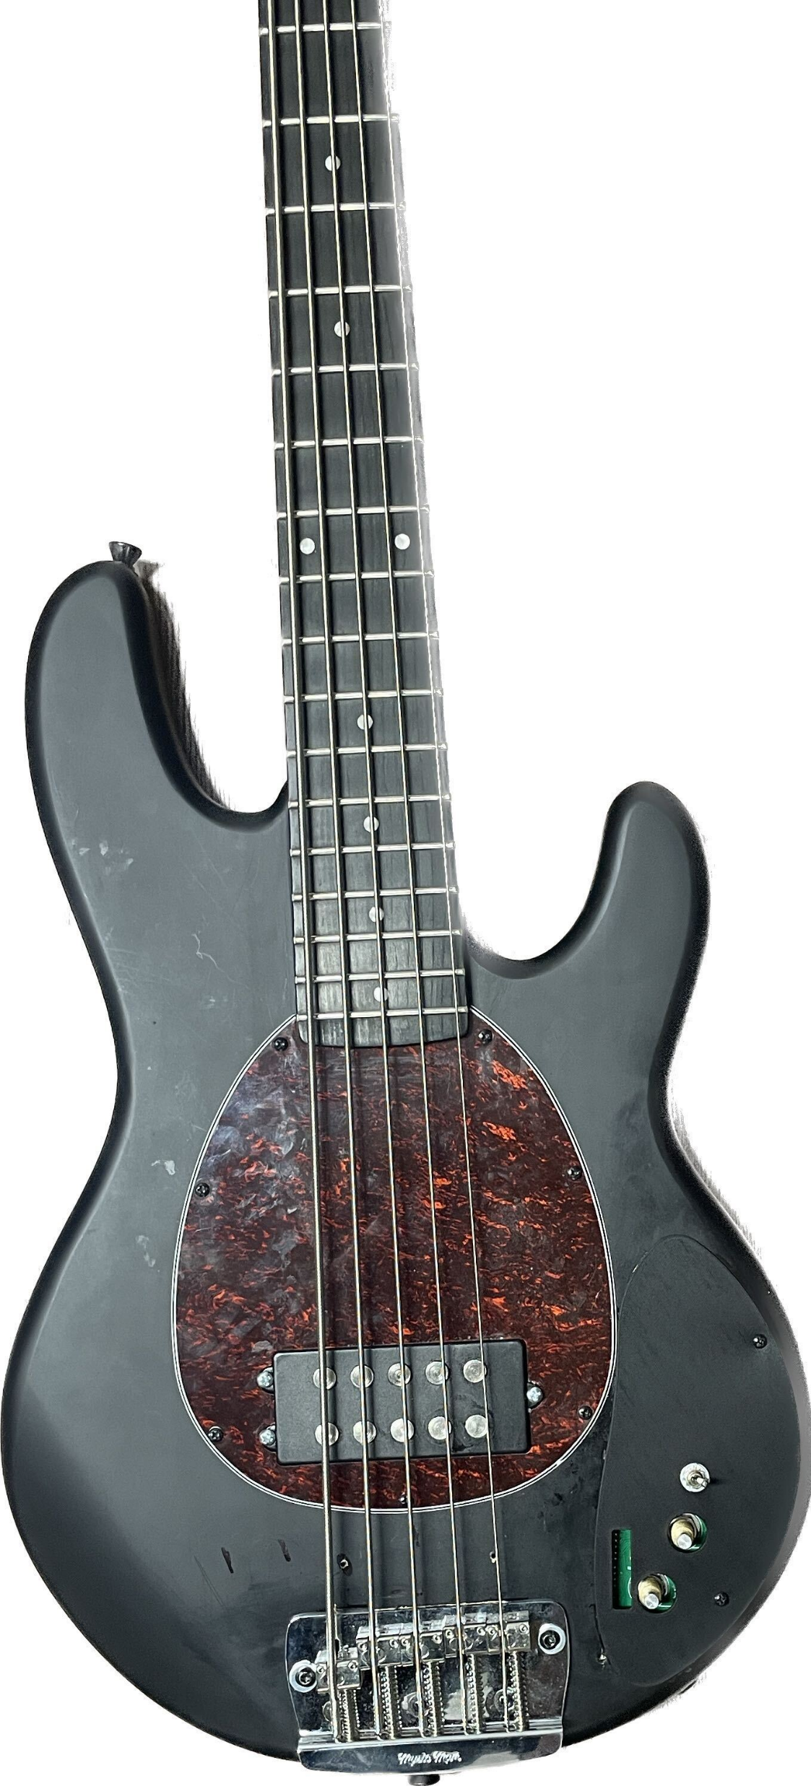
3D Printed Panel

Slide 6
Bass Guitar
Algorithm Under Test
Octaver & Synth DSP
Humbucker
Piezo
Algorithm Under Test
Spectral Analysis (Sonic Visualizer)
Algorithm Under Test
Python & Sonic Visualizer Data Flow
Pitch (F0) Estimation – PYSPTK
Pitch Difference Calculations – Flagging Mechanism
Plotting Correlation Data

